Slide 1


L3 Technologies
Multi-Robot SLAM
Roger Kleinmann, Christina Maher,
Kelly Munyan, Max Panoff

Slide 2
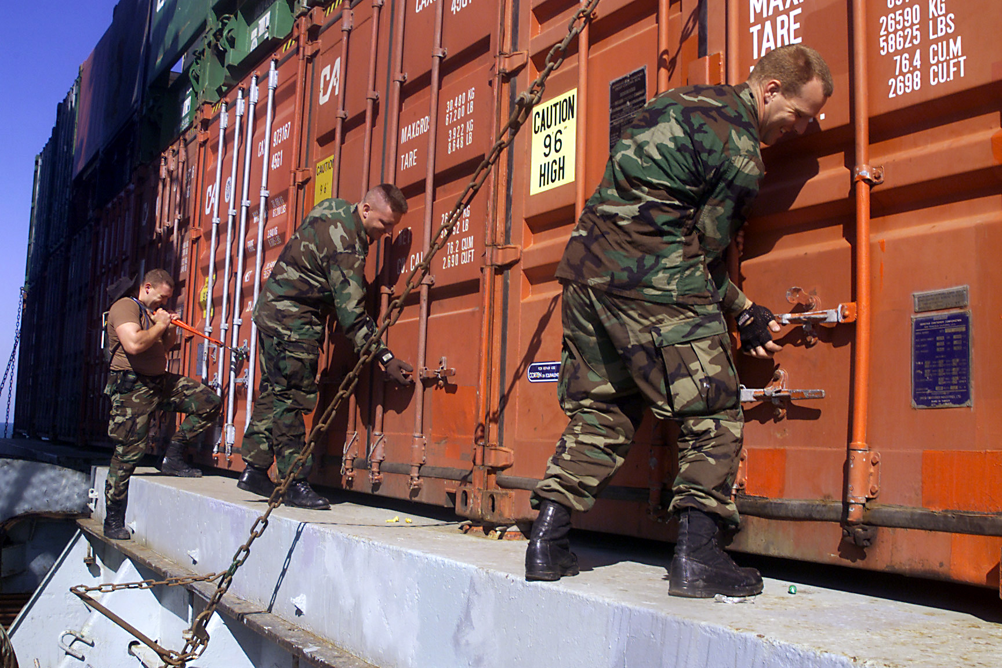
Background/Scope
Autonomous Multi-Robot System capable of:
Simultaneous Localization and Mapping (SLAM)
Using 2D LiDAR and 3D depth camera to create a map of area (i.e. commercial/naval vessels)
Useful for inspecting:
foreign ships coming into port
abandoned ships found at sea
Previous systems have faults such as:
Depending on local sensor data or wifi
Needing user input
Only creating 2D maps or low quality images
Notes:
Christina

Slide 3
Assumptions & Constraints
Assumptions:
Any ship
Initial design to be used on level ground
Prototypes not expected to surpass boundary of doorway
Robots communicate using routers on individual robots in absence of wireless connection
Mapping achieved by 2D LiDAR and 3D depth cameras
At least one human operator will monitor the system
Constraints:
Cost: $5,000+
Size: shorter than 40cm in any direction
Weight: < 3 kg
Processing Power: GPU with CUDA compute 3.0
Battery Life: at least 1 hour
Timeline: ~7 months
Notes:
Kelly

Slide 4
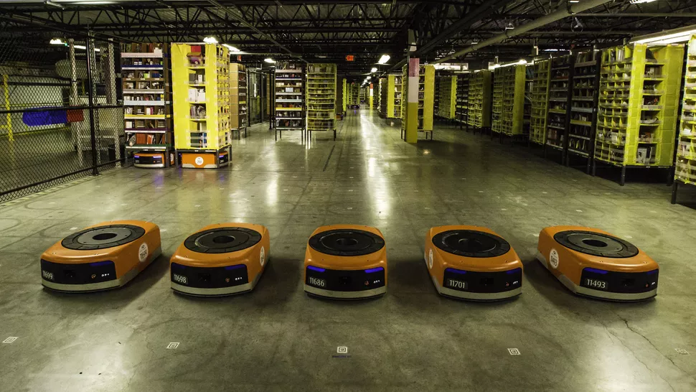
Strategy for Operation
Strategic considerations
Level of manual control
System initialization
Level of environmental instrumentation
Modes of localization
Local or central decision making
Robot hierarchy
Notes:
Roger

Slide 5
System Selection
 |  | Concepts
 |  | Waffle (TurtleBot 3) |  | Burger (TurtleBot 3) |  | TurtleBot 2e |  | Oculus Prime
Selection Criteria | Weight | Rating | Weighted Score | Rating | Weighted Score | Rating | Weighted Score | Rating | Weighted Score
Cost/quantity available | 15% | 3 | 0.45 | 8 | 1.2 | 2 | 0.3 | 5 | 0.75
Processing Capability | 20% | 9 | 1.8 | 4 | 0.8 | 6 | 1.2 | 7 | 1.4
Mobility | 10% | 6 | 0.6 | 5 | 0.5 | 5 | 0.5 | 7 | 0.7
Capacity for Modification | 5% | 9 | 0.45 | 7 | 0.35 | 9 | 0.45 | 1 | 0.05
Sensors Provided | 15% | 8 | 1.2 | 5 | 0.75 | 4 | 0.6 | 5 | 0.75
Portability | 5% | 7 | 0.35 | 8 | 0.4 | 5 | 0.25 | 3 | 0.15
Sensor Accuracy | 15% | 8 | 1.2 | 7 | 1.05 | 6 | 0.9 | 6 | 0.9
Strategy Compliance | 15% | 8 | 1.2 | 4 | 0.6 | 6 | 0.9 | 6 | 0.9
Total Score |  | 7.25 |  | 5.65 |  | 5.1 |  | 5.6
Rank |  | 1 |  | 2 |  | 4 |  | 3
Status |  | Develop |  | Reject |  | Reject |  | Reject

